Slide 1
Analyzing SpaceX Launch Success Factors

Slide 2
Objectives
To analyze the factors that influence the success of the first stage landing.
Identify launch success and failure rates.
Develop a predictive model to predict the outcome of launches.

Slide 3

Methodology
Data collection using SpaceX API and Wikipedia web scraping.
Exploratory data analysis (EDA) with visualizations and SQL.
Creation of an interactive dashboard with Plotly Dash.
Classification models for predictive analytics.

Slide 4
Deliverables
Completed Notebooks: Data Wrangling, EDA, SQL, and Machine Learning.
https://github.com/4sur/IBMDataScienceCapstone

Slide 5

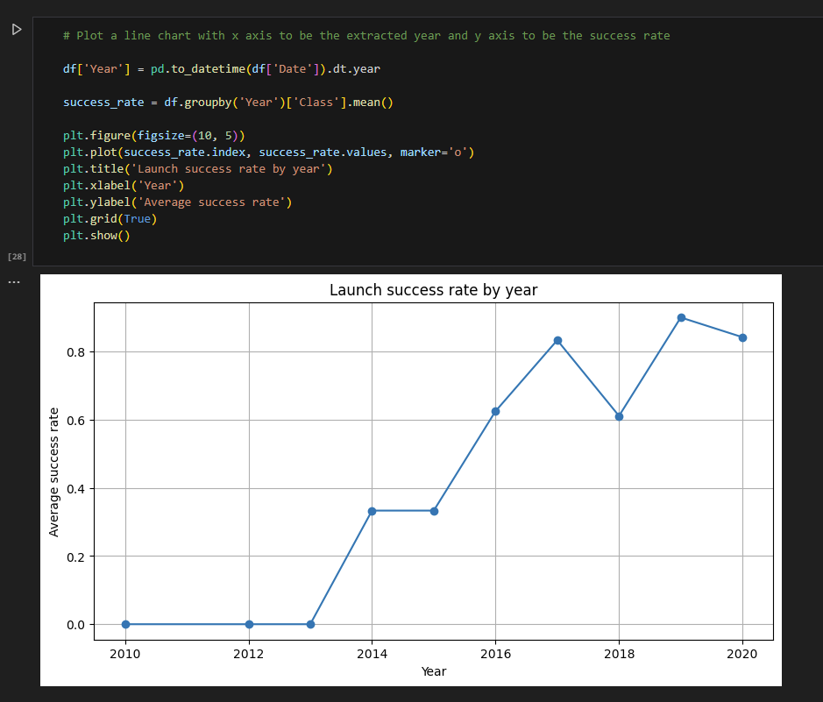
Significance of the study:
Understand the factors affecting SpaceX launch success.
Improve operational efficiency and reduce costs through data analysis.
Explore historical trends and patterns in launches.

Slide 6
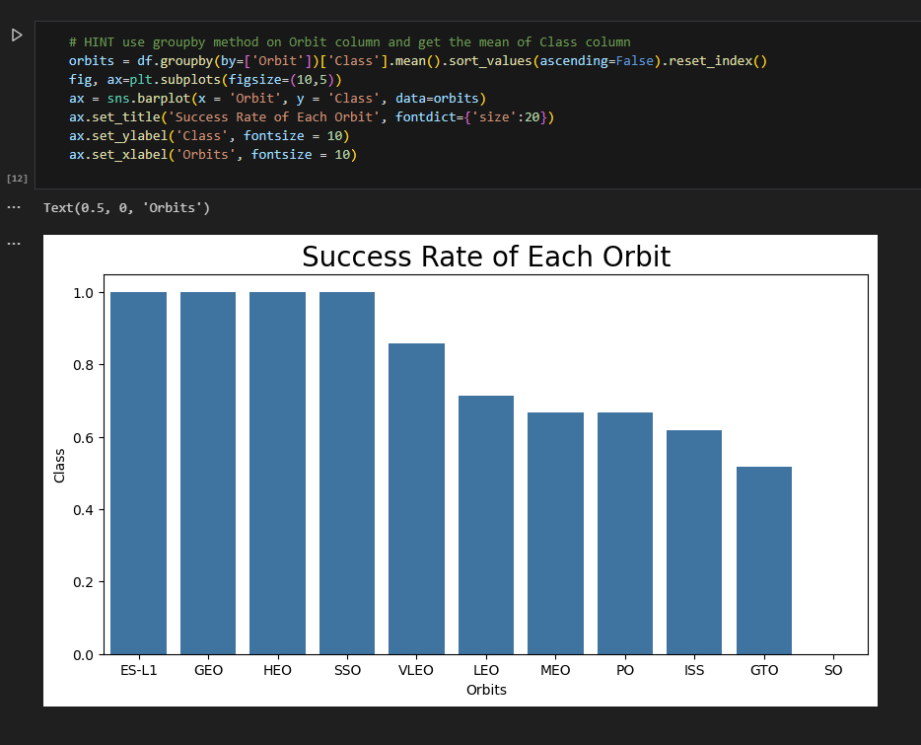
Key questions:
What are the most important factors influencing landing success?
How have success rates evolved over time?
Can the outcome of a launch be accurately predicted?

Slide 7
Data collection:
SpaceX API for detailed launch information.
Web scraping of the Falcon9 wiki page to complement the data.
Data cleaning: Handling of missing values and outliers.
Standardization of variables such as “outcome” and “landing_outcome”.
Feature Engineering: Creation of new variables such as: Categories for landing outcome (success, failure, loss).
Count of launches per site and orbit.

Slide 8
Exploratory Analysis with Visualizations

Slide 9
Key Visualizations:
Bar charts to show the number of launches per site.
Scatter plots to relate payload mass and landing outcome.
Trend curves to observe the evolution of success rates over time.
Relevant results:
Sites such as Cape Canaveral present higher number of successful launches.
GEO and GTO orbits have higher success rates than low orbits.

Slide 10
Exploratory analysis with SQL
Obtaining unique launches per site.
Count of launches with “CCA” result.
Calculation of average payload mass for each orbit.
Identification of the number of mission successes and failures.
Insights:
Cape Canaveral site is the most used site for successful launches.
GEO and GTO orbits have higher average payload mass.

Slide 11
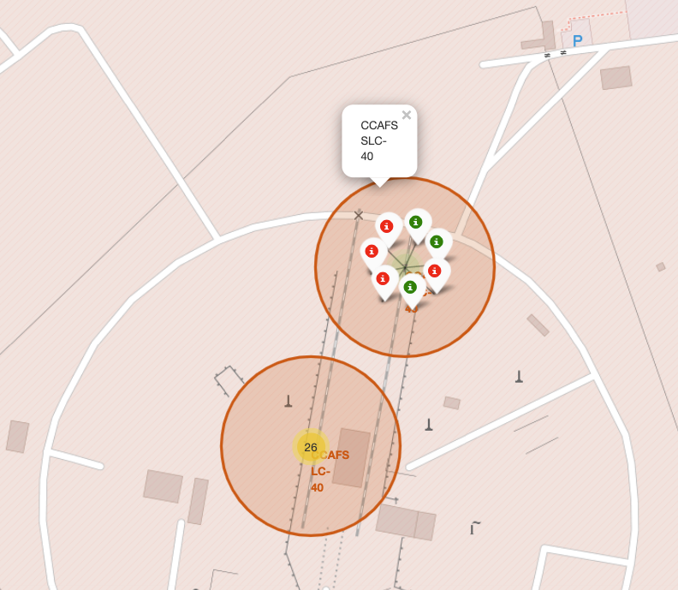
Interactive Map with Folium
Map features:
Geographic markers to visualize launch sites.
Different colors to distinguish between successes and failures.
Results:
Spatial visualization of the distribution of successful and unsuccessful launches.

Slide 12
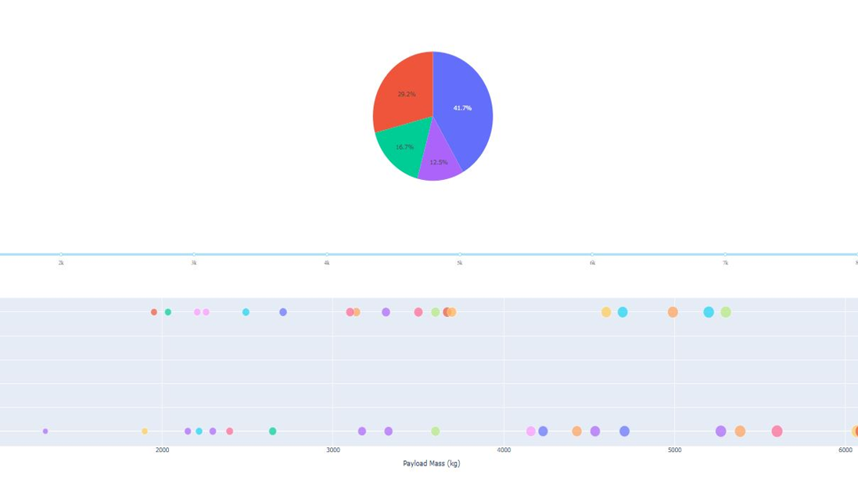
Interactive Dashboard with Plotly and Dash
Dashboard components:
- Pie chart to show the number of launches per site.
- Scatter plot to relate payload mass and landing result.
- Interactive filters to explore data by specific orbits or years.

Slide 13
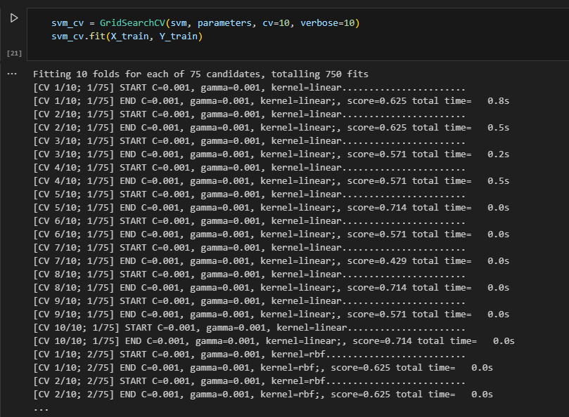
Predictive Analysis
Model process:
Division of data into training and testing.
Use of GridSearchCV to select the best hyperparameters.
Evaluation using metrics such as accuracy.
Key results:
The model achieved 90% accuracy in predicting results.
The most important features are payload mass, orbit and launch site.

Slide 14
Summary of findings:
Sites such as Cape Canaveral are key to launch success.
GEO and GTO orbits have higher success rates.
The predictive model can accurately predict the outcome of launches.
Recommendations:
Optimize resources at sites with higher probability of success.
Investigate underlying causes of failures in specific orbits.

Slide 15
Thank you
https://github.com/4sur Manu L.

